Slide 1
Operators in Python
Arithmetic, Relational, and Logical Operators
A Practical Approach

Slide 2
Arithmetic Operators
Used for mathematical operations:
+ Addition: 5 + 3 → 8
- Subtraction: 5 - 3 → 2
* Multiplication: 5 * 3 → 15
/ Division (float): 5 / 2 → 2.5
// Floor Division: 5 // 2 → 2
% Modulus (Remainder): 5 % 2 → 1
** Exponentiation: 5 ** 2 → 25

Slide 3
Relational (Comparison) Operators
Used to compare values:
== Equal to: 5 == 5 → True
!= Not equal to: 5 != 3 → True
> Greater than: 5 > 3 → True
< Less than: 5 < 3 → False
>= Greater than or equal to: 5 >= 5 → True
<= Less than or equal to: 3 <= 5 → True

Slide 4
Logical Operators
Used to combine conditions:
and Returns True if both conditions are True
or Returns True if at least one condition is True
not Negates the condition
Example:
a = True, b = False
print(a and b) → False
print(a or b) → True
print(not a) → False

Slide 5
Discussion Points
- Difference between `/` (float division) and `//` (floor division)
- Operator precedence (`**` > `* / // %` > `+ -`)
- Chained comparisons (`3 < x < 10` is valid in Python)
- Short-circuit evaluation in logical operators
- Truthy and Falsy values in Python (0, None, "", [], {} → False)

Slide 6
Hands-on Exercises
1. Compute the remainder when a number is divided by another.
2. Check if a number is even or odd using `%` and `==`.
3. Given `a = 5, b = 10, c = 15`, evaluate expressions:
- `(a < b) and (b < c)`
- `not (a > c)`
4. Write a program to check if a number is in the range [10, 50].

Slide 7
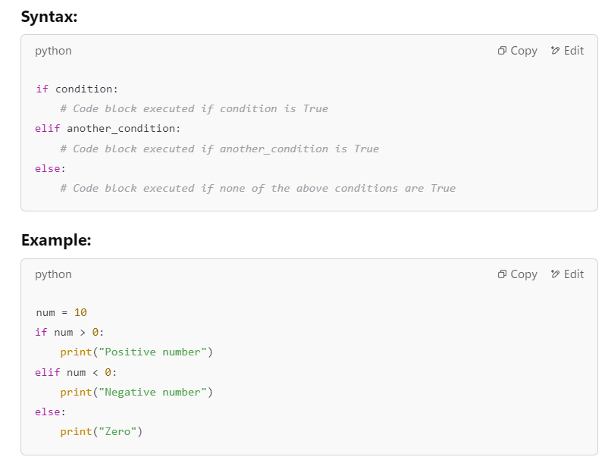
Conditional Statements

Slide 8
For Loop
Used for iterating over sequences (lists, strings, etc.)
Syntax:
for variable in sequence:
# Code executed in each iteration
Example:
for i in range(5): # range(5) generates [0,1,2,3,4]
print("Iteration:", i)
- `range(start, stop, step)` allows custom ranges
- Can iterate over lists, strings, and tuples

Slide 9
While Loop
Executes a block of code as long as the condition remains True.
Syntax:
while condition:
# Code executed repeatedly
Example:
count = 0
while count < 5:
print("Count:", count)
count += 1
- Beware of infinite loops (`while True`)
- Use `break` to exit early, `continue` to skip iterations

Slide 10
Control Statements
Used to alter loop execution:
- `break` → Exits the loop prematurely
- `continue` → Skips the current iteration
- `pass` → Placeholder for future code
Example:
for i in range(5):
if i == 2:
continue # Skip when i is 2
if i == 4:
break # Stop loop when i is 4
print(i)

Slide 11
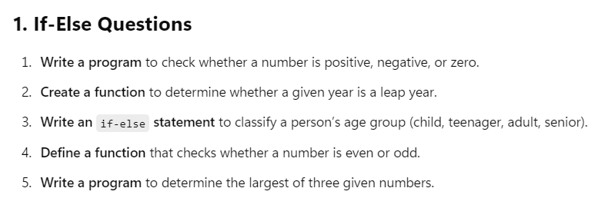
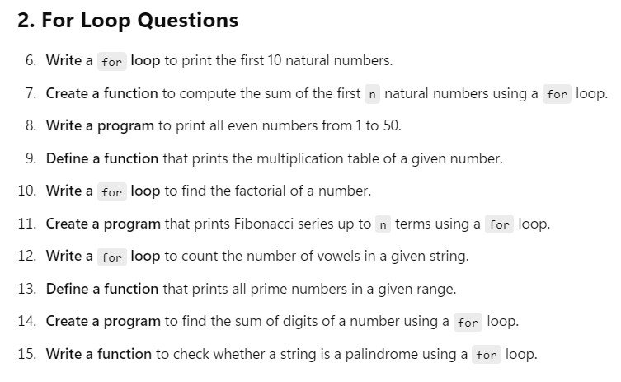
Hands-on Exercises

Slide 12
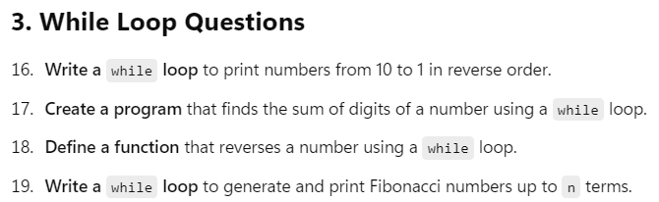

Slide 13
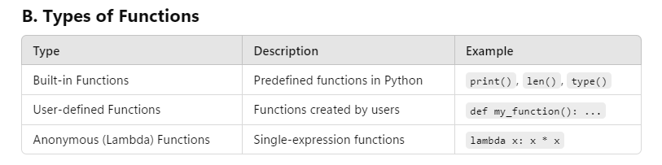
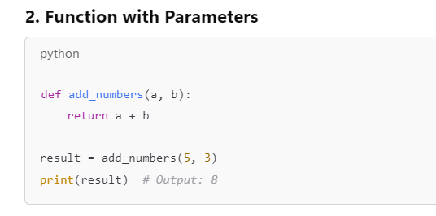
Functions in Python

Slide 14
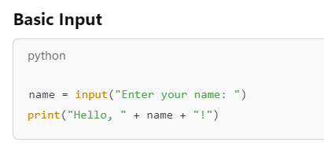
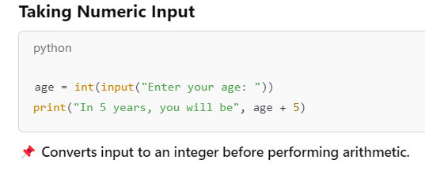
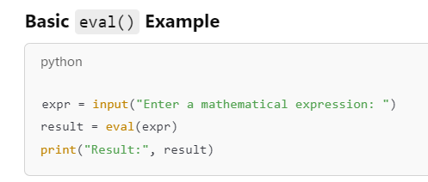
User Input in python

Slide 15
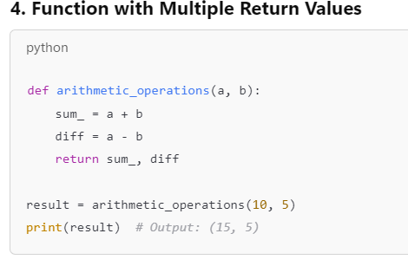
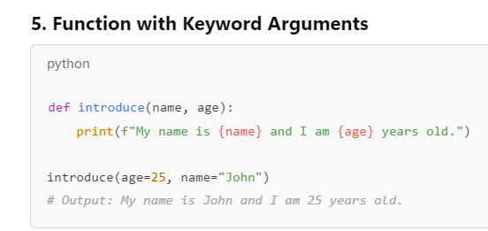
Types of Functions

Slide 16
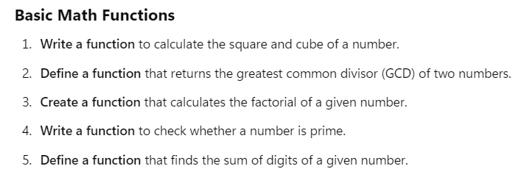

Slide 17
Modules in Python
Modules are Python files containing functions, variables, and classes.
Creating a module (`mymodule.py`):
# mymodule.py
def greet(name):
return f"Hello, {name}!"
Using the module:
import mymodule
print(mymodule.greet("Alice")) # Output: Hello, Alice!

Slide 18
Standard Python Modules
Python provides built-in modules:
- `math` → Mathematical operations
- `random` → Random number generation
- `datetime` → Working with dates and time
- ‘numpy’ → For numerical computations
- ‘sympy’- → For symbolic (algebraic) computations
-- ‘matplotlib’- → For plotting.
Example (`math` module):
import math
print(math.sqrt(25)) # Output: 5.0
print(math.pi) # Output: 3.141592653589793

Slide 19
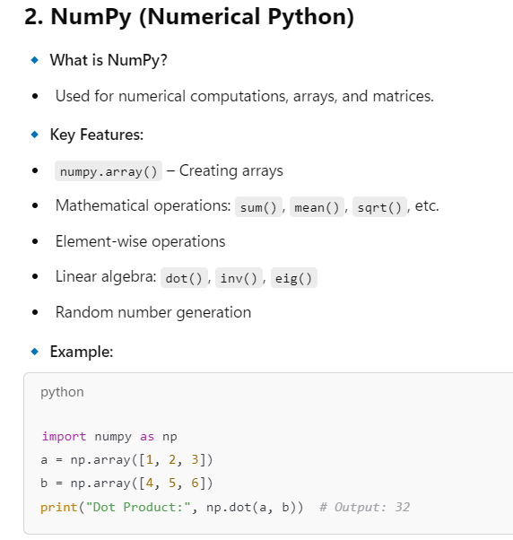
Introduction to Key Libraries for Mathematics

Slide 20
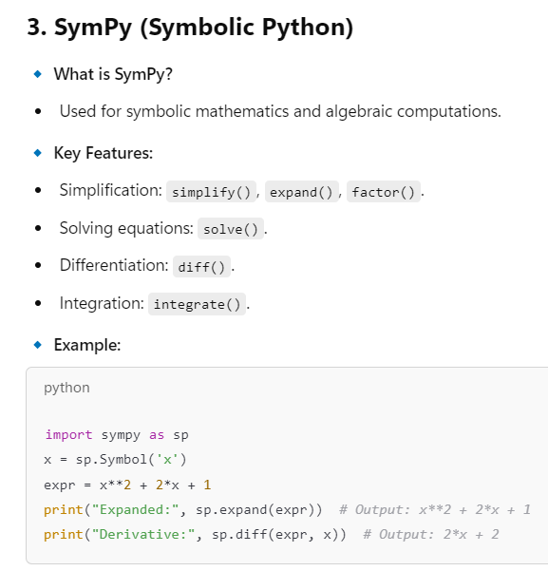

Slide 21
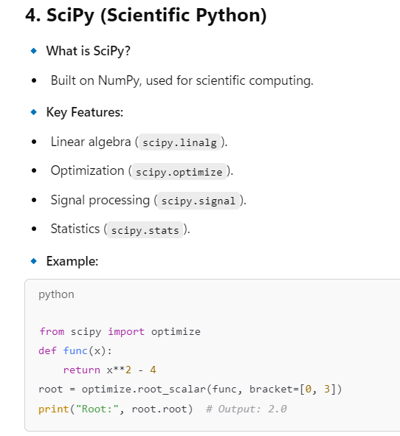

Slide 22
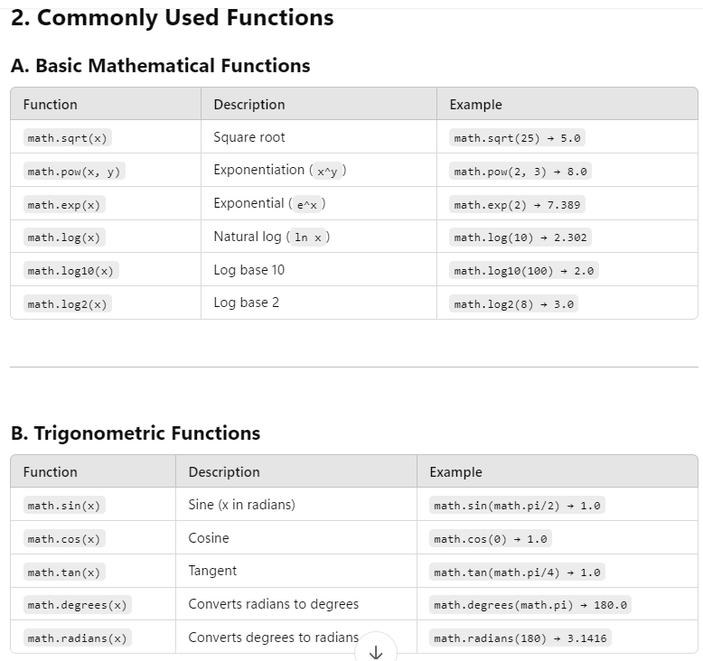
the math Library
The math library

Slide 23
